Slide 1


Slide 2

ARRAY METHODS IN JS

Slide 3
Array Methods
Since JS treats arrays as objects so it provides us a whole bunch of predefined methods which make working with arrays easier.
Based upon their working we can divide these methods into following groups:
Methods for Adding new elements in the array
Methods for Removing elements from the array
Methods for Copying array elements
Methods for Searching in array
Methods for Transforming an array

Slide 4
Methods For Adding New Elements In Array
push(): Adds one or more elements to the end of an array, and returns the new length of the array.
unshift(): Adds one or more elements to the beginning of an array, and returns the new length of the array.

Slide 5
Methods For Removing Elements From Array
pop(): Removes the last element from an array and returns that element.
shift(): Removes the first element from an array and returns that element

Slide 6
Method For Adding/Removing/Replacing Elements From Array
splice(): changes the contents of an array by removing or replacing existing elements and/or adding new elements.
Syntax:
arr.splice(start[, deleteCount, elem1, ..., elemN])
It modifies the array arr starting from the index start: removes deleteCount elements and then inserts elem1, ..., elemN at their place.
Finally returns the array of removed elements.

Slide 7
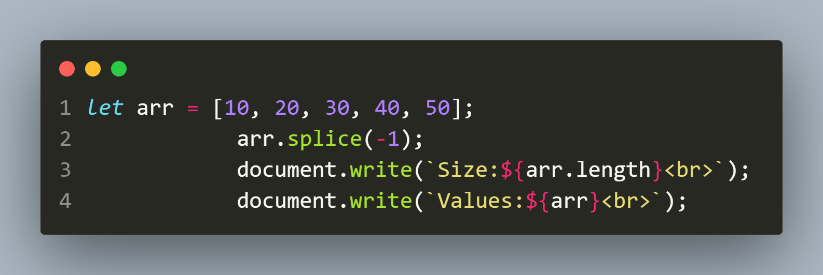
Using “Negative Indexing” With Array
In the method splice() and many other array methods, negative indexes are allowed.
They specify the position from the end of the array, like here:
OUTPUT:
Size:4 Values:10,20,30,40

Slide 8
Methods For Copying Array Elements
slice(): Returns a copy of a portion of an array into a new array object selected from start to end-1 where start and end represent the index of items in that array.
Syntax:
arr.slice(start[, end])
If end is not present then returns the entire array from start .
If both are missing then returns the entire array from 0th index .

Slide 9
Methods For Copying Array Elements
of(): Newly added by ES6 , it is a static method and creates a new Array instance from the given arguments
Syntax:
Array.of(arg1,arg2,. . .)
It accepts any number of arguments – either arrays or values.
The result is a new array containing arg1, arg2 etc.

Slide 10
Methods For Copying Array Elements
concat(): Returns a new array containing items of calling array joined with other array(s) and/or value(s).
Syntax:
arr.concat(arg1,arg2,. . .)
It accepts any number of arguments – either arrays or values.
The result is a new array containing items from arr, then arg1, arg2 etc.

Slide 11
Methods For Copying Array Elements
fill(): Newly added by ES6 , this method overwrites existing values with a new value passed as argument
Syntax:
arr.fill(value,[start,[end]])
value: the new data to be placed.
start: The starting index
end: The end index

Slide 12
Methods For Searching Elements In Array
includes(): Newly added by ES7 , this method determines whether an array includes a certain value among its entries, returning true or false as appropriate.
indexOf(item,start): Returns the first index of the specified item or -1 if element is not found. The start value is optional and indicates the starting index of search. It’s default value is 0 .

Slide 13
Methods For Searching Elements In Array
lastIndexOf(): Returns the last index at which a given element can be found in the array, or -1 if it is not present.

Slide 14
Methods For Transforming An Array
sort(): Sorts the elements of an array in place and returns the reference to the same array, which is now sorted.
The default sort order is ascending, built upon converting the elements into strings, then comparing.
reverse(): reverses an array in place and returns the reference to the same array, the first array element now becoming the last, and the last array element becoming the first.

Slide 15
Methods For Transforming An Array
join([symbol]): creates and returns a new string by concatenating all of the elements of the array , separated by commas or a specified separator string.
toString(): creates and returns a new string by concatenating all of the elements of the array , separated by commas.

Slide 16
New Method Added By ES2022
at(index): Takes an integer value and returns the item at that index, allowing for positive and negative indexing.

Slide 17
Important Note
There are some more methods to work with arrays like
forEach()
map()
reduce()
filter()
We will discuss them after we understand a very important concept in JS called as CALLBACK

Slide 18
ASSIGNMENT 1
Write a JavaScript code to accept 5 names from the user and store them in an array. Now ask the user to input another name and print all the occurrences of this name in the given array using the array method indexOf(). In case the given name is not found at all, print the message name not found

Slide 19
ASSIGNMENT 2
Write a JavaScript code to accept 5 nos from the user in an array . Now ask the user to enter another no and remove all it’s occurrences from the array.

Slide 20
ASSIGNMENT 3
Write a JavaScript code to remove all the duplicate elements from an array.

Slide 21
ASSIGNMENT 4
Write a JavaScript program to remove '0', false, undefined, null, NaN, '' from given array.
Sample Data:
Input: Array: [NaN, 0, 15, false, -22, '',undefined, 47, null,94]
Output: [15, -22, 47, 94]

Slide 22
ASSIGNMENT 5
Write a JavaScript code to divide a given array of positive integers into two parts. First element goes to first part, second element goes to second part, and third element goes to first part and so on. Now compute the sum of two parts and store into an array and print it.
Sample Data:
Input: Array: [1, 3, 6, 2, 5, 10]
Output: [12, 15]

